Slide 1
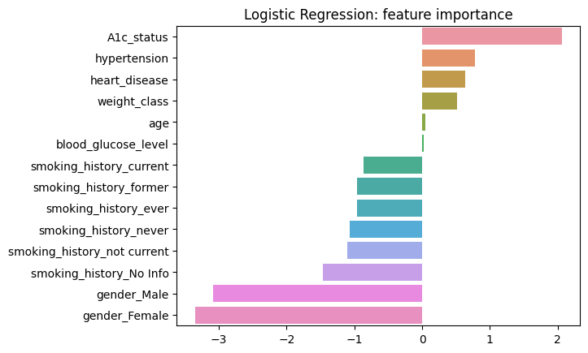
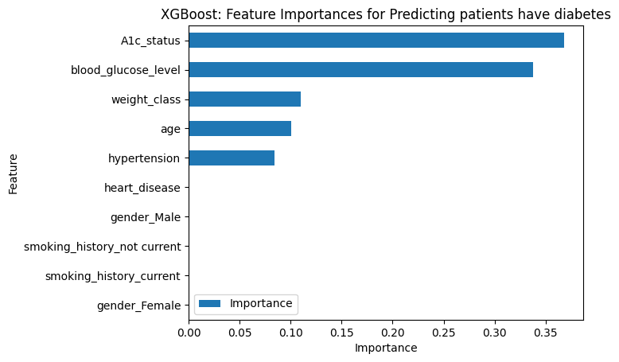
Diabetes Prediction Project
Help healthcare professionals to identify patients who may be at risk of developing diabetes and in developing personalized treatment plans.
Since the variable we are seeking to predict is categorical, we could build either a logistic regression or a tree-based machine learning model.
The XGBoost model outperforms the decision tree model and random forest model.
Barplot above shows `A1c_status`, `hypertension` are the most positive correlation, while `gender` variable plays the most negative correlation to target variable
This model helps predict whether a patients is in risk of having diabetes and identify which factors are most influential. These insights can help healthcare professionals develop personalized treatment plans timely
In the XGBoost model above, `A1c_status`, `blood_glucose_level`, `weight_class`, `age`, and `hyperstension` have the highest importance. These variables are most helpful in predicting the outcome variable, `diabetes`.
Test the model with selected group of patients in real world to get feedback

